Slide 1
Predicting Obesity in Individuals
By Kadin McWilliams

Slide 2
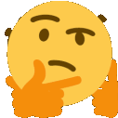
What is the biggest health crisis in America?

Slide 3
Introduction
Topic
Predicting obesity in individuals using logistic regression
With?
Using height, weight, and health lifestyle choices from an obesity data set
How?
Using 4 different models testing 80/20, 70/30, all independent variables, height and weight excluded

Slide 4
Background on Obesity
Obesity Levels
Obesity Class 1
BMI 30.0 to 34.9
Obesity Class 2
BMI 35 to 39.5
Obesity Class 3
BMI greater than 40.0
Health risks associated with obesity
Cardiovascular disease
Type 2 diabetes
Musculoskeletal disorders
Sleep apnea
Liver disease
High blood pressure
Some forms of cancer (endometrial, breast, and colon)

Slide 5
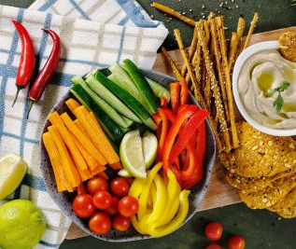
What are health lifestyle choices?
Questions to ask about health lifestyle choices
Do you smoke?
How much water do you drink daily?
How much physical activity do you get daily?
How many vegetables do you eat daily?
How do you get to work/school?

Slide 6
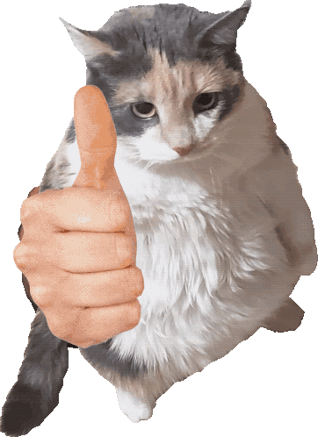
Dataset Background
23% of data was collected on a web platform
77% was created synthetically using generative AI
Original studies goal was to find predicting factors of obesity

Slide 7
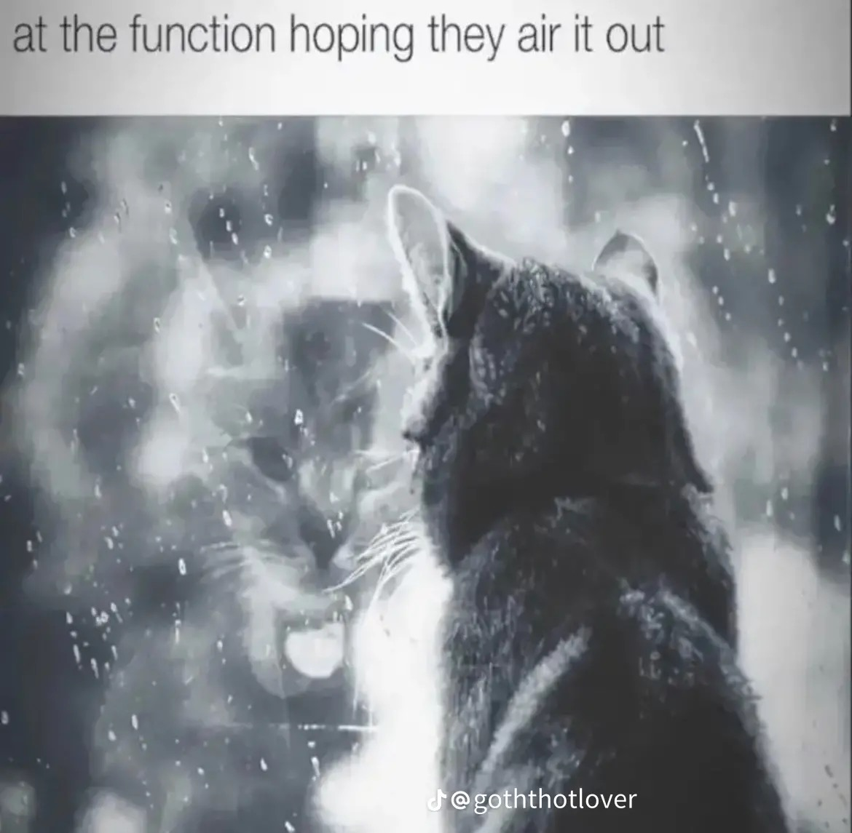
Exploring the Data
Table 1: Data Types
Variable Name | Data Type
V1 Age | float64
V2 Gender | object
V3 Height | float64
V4 Weight | float64
V5 Alcohol | object
V6 HighCaloricIntake | object
V7 VegtableIntake | float64
V8 DailyMeals | float64
V9 CalorieMonitoring | object
V10 Smoke | object
V11 DailyWaterIntake | float64
V12 family_history_with_overweight | object
V13 PhysicalActivity | float64
V14 TechnologyUsage | float64
V15 FoodBetweenMeals | object
V16 MTRANS | object
V17 ObesityLevel | object
Basic Data Information
2,111 samples
17 columns
9 categorical
8 numerical
Contained no missing values
Translated from Spanish to English

Slide 8
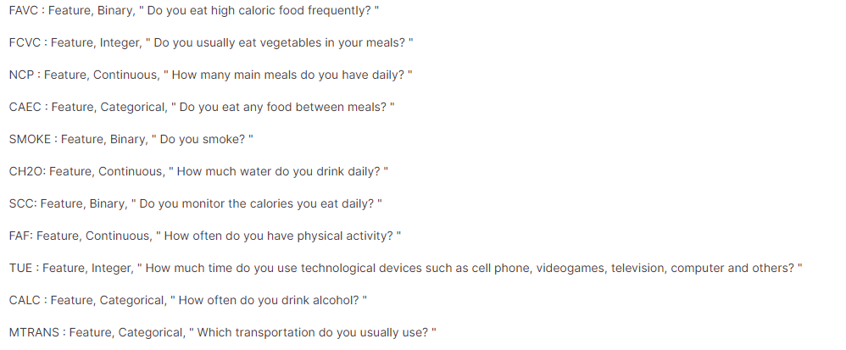
Variable Interpretation

Slide 9
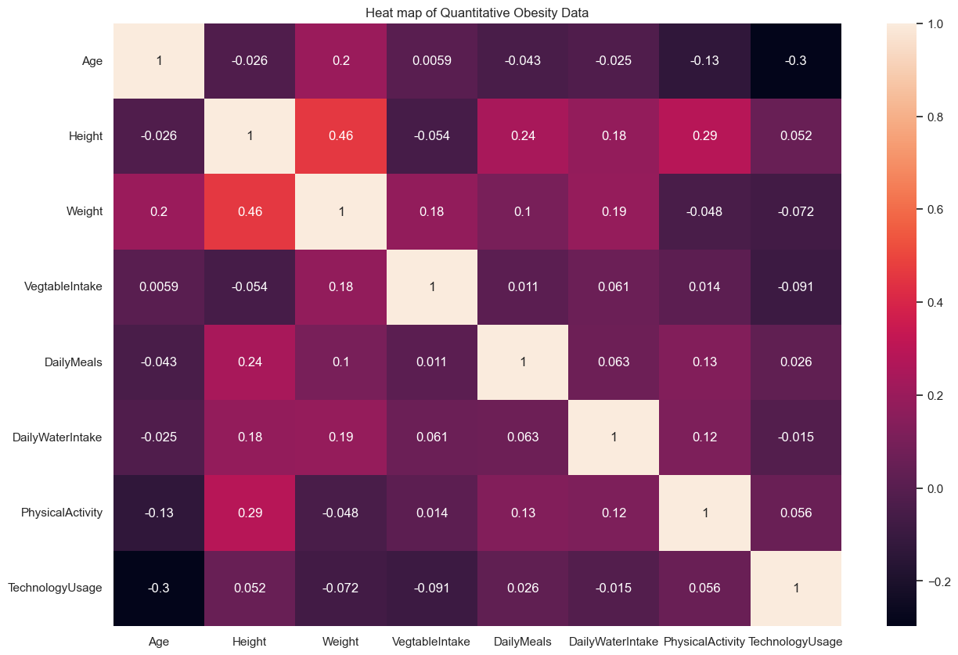
Heatmap of Quantitative Data & Statistics on The Average Person
Important Heatmap Information
Moderate correlation between height and weight
Height had a higher correlation with daily physical activity and daily meals than weight did.
Average Person in Dataset
5 feet 7 inches tall
190 pounds
BMI of 29.8, 0.2 from obesity class 1

Slide 10
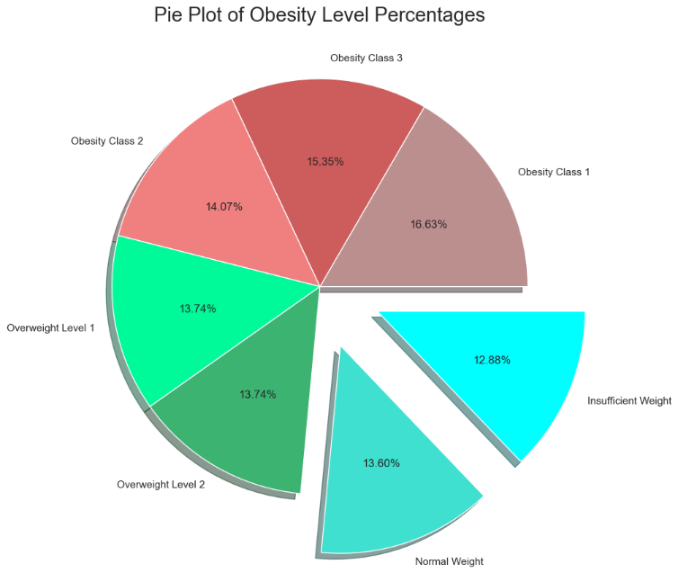
Pie Plot of Obesity Level Percentages
Important Information
73.52% of participants are obese or overweight
26.48% are normal weight or underweight
Dataset is heavily skewed towards obese and overweight obesity levels

Slide 11
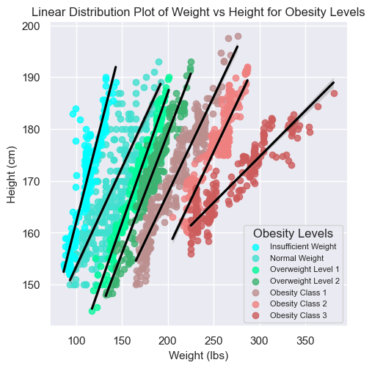
Linear Distribution Plot of Weight vs Height for Obesity Levels
Important information
Underweight to obesity class 2 have similar slopes
Obesity class 3 has a significantly lower slope compared to the other levels
Obesity class 3 has a significant increase in weight to height ratio

Slide 12
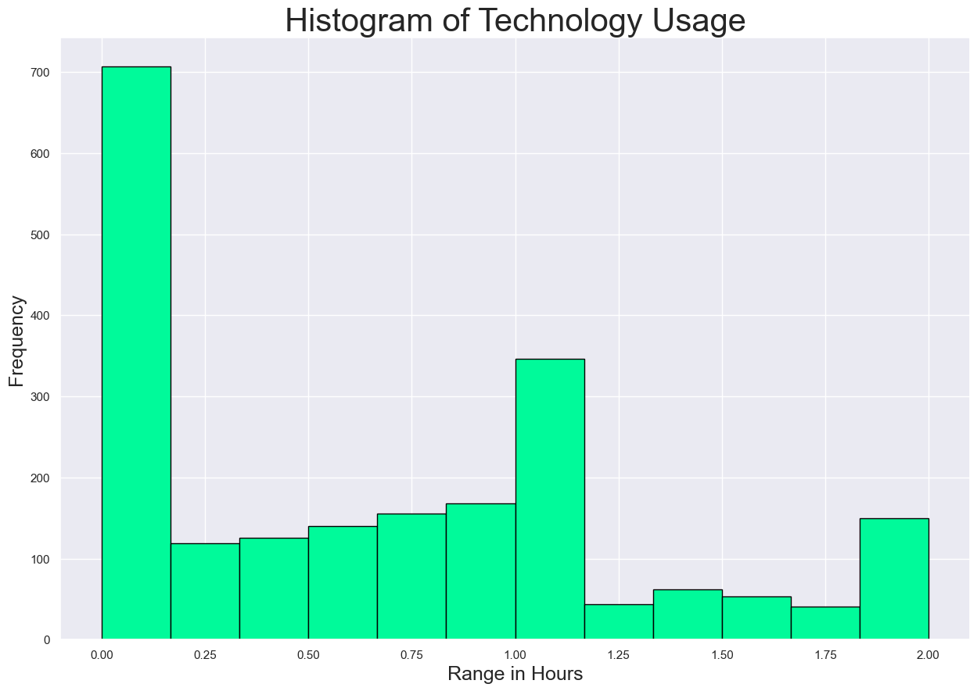
Histogram of Technology Usage
Important information
Minimum value of 0
Maximum value of 2
Approximately 33% of entries are 0
Skewed right
Data seems illogical as this was an online survey
Translation issues?

Slide 13
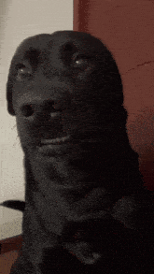
Final Unusual Occurrence
Strange Data Inputs
Decimal inputs for things that should be integers
Example
“How much water do you drink daily?”
Answer - 1.0245 bottles
Columns affected
VegtableIntake
DailyWaterIntake
PhysicalActivity
Age
DailyMeals
Hypothesis
AI used for data synthesis created floating point numbers in columns that should only be integers.

Slide 14
Data Exploration Summary
Moderate correlation between height and weight
73.52% of participants are obese or overweight
Obesity class 3 has a significant increase in weight to height ratio
Technology usage column has illogical data
5 columns with unusual decimal inputs

Slide 15
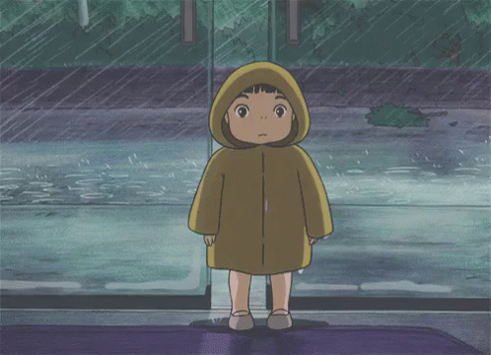
Methods
Data Preparation
Cleaning Data
Updating column names
Fixing decimal inputs to integers
Converting meters to centimeters
Converting kg to pounds
Independent variables
Variable list
Age
Gender
Height
Weight
Alcohol consumption
if one has a high caloric intake
Daily vegetable intake
Daily meals
Categorical
One hot shot encoding
Numerical
Scaling to range normalization
Raw Data Group
All independent variables
Lifestyle Data Group
All independent variables excluding height and weight
Dependent variable
Obesity level
Encoded using OrdinalEncoder from SKLearn
If one monitors their calories
If the individual smokes
Daily water intake
Overweight Family History
Daily physical activity
Technology usage per day
If one eats food in between meals
Daily transportation method

Slide 16
Experimental Design
Experimental Goals
Experiment 1 & Experiment 2
See if obesity level can be predicted
Test difference in model accuracy between 80/20 and 70/30 split
Provide a control/comparison group for the lifestyle data group
Experiment 3 & Experiment 4
See if weight can be predicted based on lifestyle choices
Again, testing difference in model accuracy between 80/20 and 70/30 split
Experiment Number | Parameters
1 | All independent variables with 80/20 split for train and test.
2 | All independent variables with 70/30 split for train and test.
3 | All independent variables excluding height and weight with 80/20 split for train and test.
4 | All independent variables excluding height and weight with 70/30 split for train and test.

Slide 17
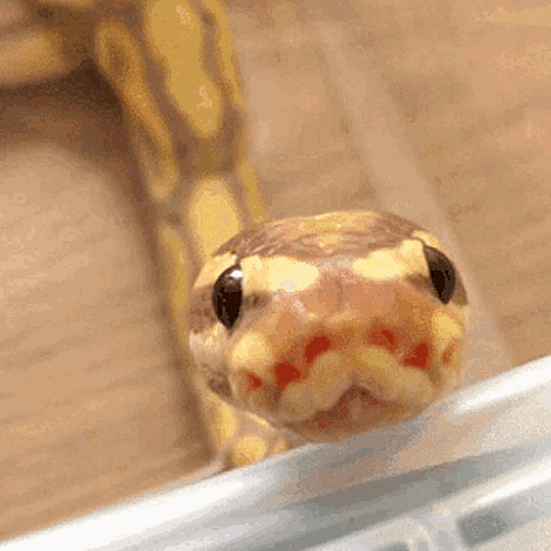
Tools Used
Main Tools
Python v3.11.4
Anaconda v2.5.0
Windows 10 computer
Python Libraries
Pandas v1.5.3
Matplotlib v3.7.1
Seaborn v0.12.2
Numpy v1.24.3
SKLearn v1.3.0
Statsmodels v0.14.0
Python Powered Analytics

Slide 18
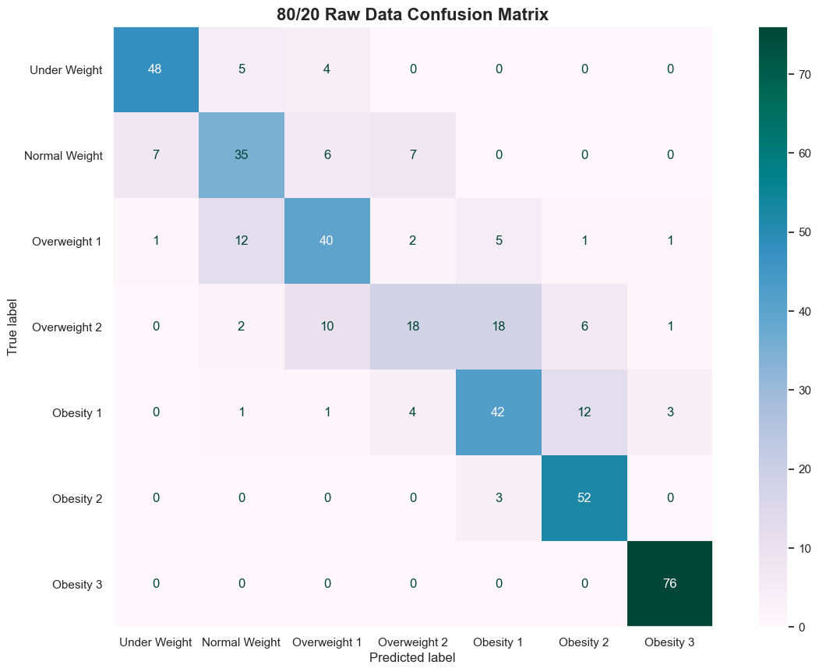
Experiment 1 Results – 80/20 Raw Data
Important Information
Obesity Class 3 & underweight f1-score
0.74 overall accuracy
Ends of obesity level are accurate, center of spectrum is not
80/20 Raw Classification Report
 | Precision | Recall | F1-Score | Support
Under Weight | 0.86 | 0.84 | 0.85 | 57
Normal Weight | 0.64 | 0.64 | 0.64 | 55
Overweight Level 1 | 0.66 | 0.65 | 0.65 | 62
Overweight Level 2 | 0.58 | 0.33 | 0.33 | 55
Obesity Class 1 | 0.62 | 0.67 | 0.67 | 63
Obesity Class 2 | 0.73 | 0.95 | 0.95 | 55
Obesity Class 3 | 0.94 | 1.00 | 1.00 | 76
Accuracy |  |  | 0.74 | 423
Macro Avg | 0.72 | 0.72 | 0.71 | 423
Weighted Avg | 0.73 | 0.74 | 0.72 | 423

Slide 19
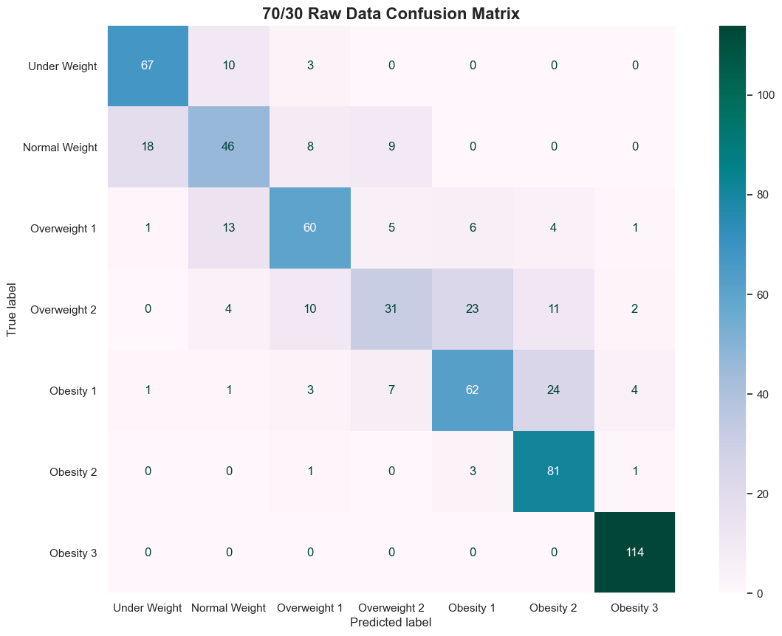
Experiment 2 Results – 70/30 Raw Data
Important Information
Obesity Class 3 & underweight f1-score
0.73 overall accuracy
Overweight level 2 is more accurate than in experiment 1
70/30 Raw Classification Report
 | Precision | Recall | F1-Score | Support
Under Weight | 0.77 | 0.84 | 0.80 | 80
Normal Weight | 0.62 | 0.57 | 0.59 | 81
Overweight Level 1 | 0.71 | 0.67 | 0.69 | 90
Overweight Level 2 | 0.60 | 0.38 | 0.47 | 81
Obesity Class 1 | 0.66 | 0.61 | 0.63 | 102
Obesity Class 2 | 0.68 | 0.94 | 0.79 | 86
Obesity Class 3 | 0.93 | 1.00 | 0.97 | 114
Accuracy |  |  | 0.73 | 634
Macro Avg | 0.71 | 0.71 | 0.70 | 634
Weighted Avg | 0.72 | 0.73 | 0.72 | 634

Slide 20
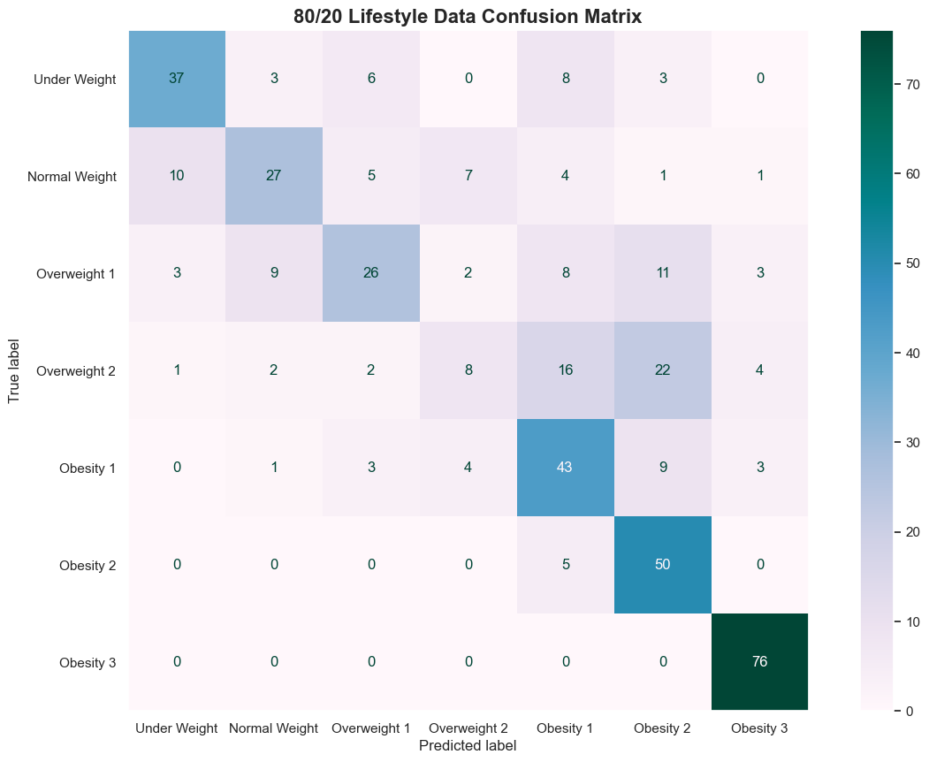
Experiment 3 Results – 80/20 Lifestyle Data
Important Information
Lower accuracy across all levels
0.63 overall accuracy
Ends of obesity class 3 retains a high f1-score of 0.93
80/20 Lifestyle Classification Report
 | Precision | Recall | F1-Score | Support
Under Weight | 0.73 | 0.65 | 0.69 | 57
Normal Weight | 0.64 | 0.49 | 0.56 | 55
Overweight Level 1 | 0.62 | 0.42 | 0.50 | 62
Overweight Level 2 | 0.38 | 0.15 | 0.21 | 55
Obesity Class 1 | 0.51 | 0.68 | 0.59 | 63
Obesity Class 2 | 0.52 | 0.91 | 0.66 | 55
Obesity Class 3 | 0.87 | 1.00 | 0.93 | 76
Accuracy |  |  | 0.63 | 423
Macro Avg | 0.61 | 0.61 | 0.59 | 423
Weighted Avg | 0.62 | 0.63 | 0.61 | 423

Slide 21
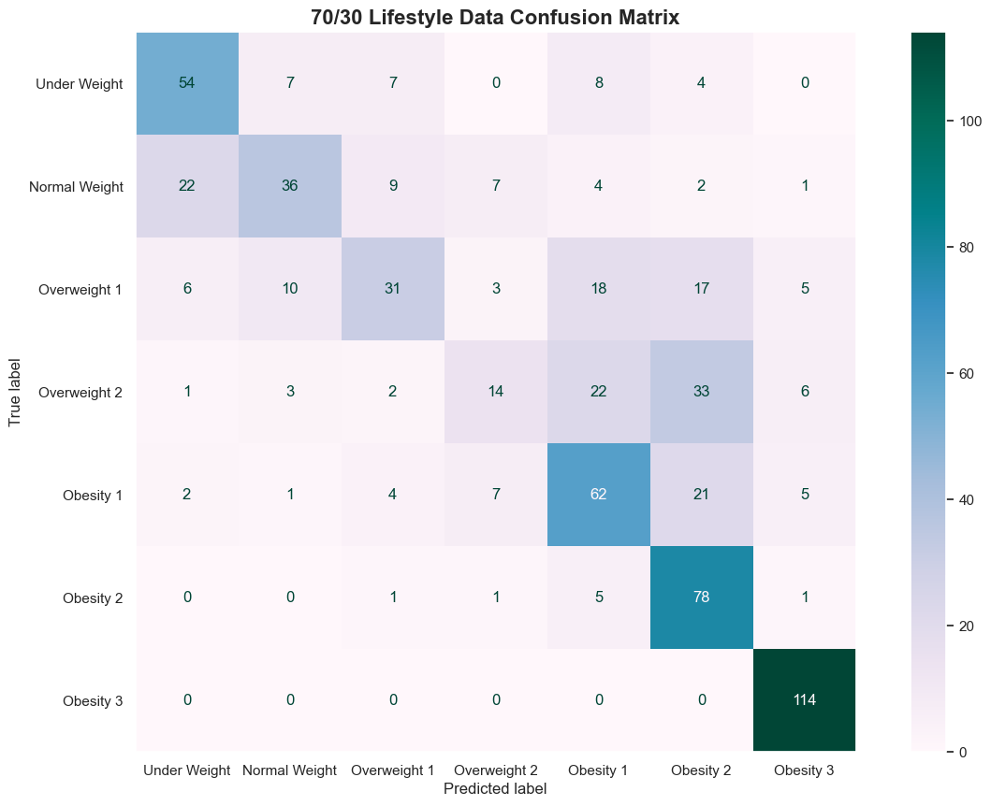
Experiment 4 Results – 70/30 Lifestyle Data
Important Information
Worst performing model
0.61 overall accuracy
Still retains high accuracy score for obesity class 3 of 0.93
70/30 Lifestyle Classification Report
 | Precision | Recall | F1-Score | Support
Under Weight | 0.64 | 0.68 | 0.65 | 80
Normal Weight | 0.63 | 0.44 | 0.52 | 81
Overweight Level 1 | 0.57 | 0.34 | 0.43 | 90
Overweight Level 2 | 0.44 | 0.17 | 0.25 | 81
Obesity Class 1 | 0.52 | 0.61 | 0.56 | 102
Obesity Class 2 | 0.5 | 0.91 | 0.65 | 86
Obesity Class 3 | 0.86 | 1.00 | 0.93 | 114
Accuracy |  |  | 0.61 | 634
Macro Avg | 0.60 | 0.59 | 0.57 | 634
Weighted Avg | 0.61 | 0.61 | 0.59 | 634

Slide 22
Discussion of Results
General Take Aways from Experiments
Experiment 1 had best predictions and accuracy score
Model is good at predicting ends of obesity levels but terrible at overweight levels
Experiment 3 showed that health lifestyle choices can predict obesity class 3
80/20 models performed better in accuracy
70/30 had better middle predictions of obesity level
Statistics on Obesity class 3
99% of people with obesity class 3
Sometimes drink alcohol,
Take public transportation,
Are women,
Have a high caloric intake,
And do not smoke
100% of people with obesity class 3
do not do any form of calorie monitoring,
eat 3 meals a day,
Have history of overweight family members
People in obesity class 3 have similar averages to population for remaining variables

Slide 23


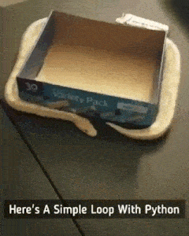
Problems Encountered
Dataset translation
Unusual Reponses
Encoding dependent variable
Training logistic regression models
Creating quality confusion matrices

Slide 24
Limitations of Implementation
Dataset validity
Poor generalizability
Lower than optimal accuracy score
Interpretation of original dataset
BMI can sometimes be misleading

Slide 25
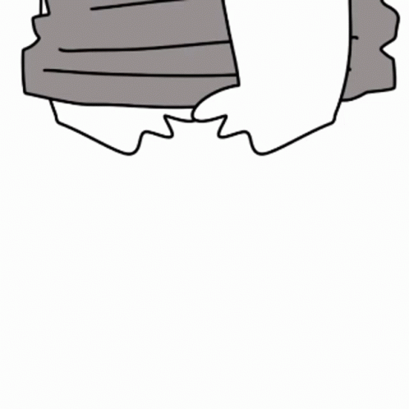
Potential Improvements
Better dataset
Changing one hot shot encoding to encoding using OrdinalEncoder for ordinal independent variables
Adding BMI variable

Slide 26
Conclusion
The logistic regression model 1 had the best f1-score accuracy at 0.74
All models were able to accurately predict obesity class 3 in individuals
Models need more work to be applicable in real world
Even with health lifestyle only data
80/20 models performed the best
Predicting obesity based on health lifestyle is a realistic goal with work
Potential factors that go into obesity class 3
High caloric intake
Drinking alcohol
Driving as main method of transportation
Family history
Not monitoring calories

Slide 27
Image References
https://www.planetfitness.com/community/articles/6-small-and-healthy-lifestyle-changes-can-make-big-difference
https://genv.org/10-benefits-of-a-healthy-lifestyle/
https://www.freepik.com/premium-ai-image/man-coding-intensely-advanced-workstation-surrounded-by-multiple-screens-neonlit-room_115458921.htm
https://tenor.com/view/ponyo-hayao-miyazaki-ghibli-studio-ghibli-rain-gif-4067659
https://tenor.com/view/thinking-gif-19466821
https://tenor.com/view/tiktok-dog-awkward-dog-confused-awkward-confused-dog-gif-2881577801438605193
https://tenor.com/view/thumbs-up-cat-thumb-thums-up-gif-10039763291952851321
https://tenor.com/view/snakes-animal-hiss-gif-17893457
https://stackoverflow.design/brand/logo/
https://altusfineart.com/blogs/news/jesus-comforting-20-images-and-artwork
https://tenor.com/view/sechi-youtube-cat-work-making-gif-18637387

